Slide 1
Windows Lateral Movement
Offensive Security

Slide 2
Windows Tokens
An access token is an object that describes the security context of a process or thread.
When you’re on a machine you are in some process
That process has a token
Think of them like web cookies
Tokens can authenticate a user
2 types of tokens
Delegation
Impersonation

Slide 3
Windows Tokens
Delegation
Interactive logons and RDP sessions
Impersonation
Non-interactive logons, logon scripts, attaching to a network drive
Tokens persist until reboot

Slide 4
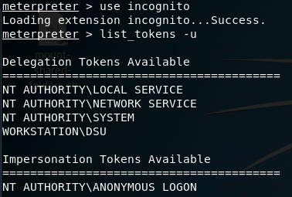
Incognito
Initially standalone, added into meterpreter
Admins can see system
But not all tokens
If you land as System you may not be able to pivot

Slide 5
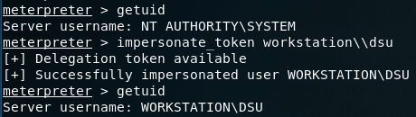
Stealing a token

Slide 6
Token Stealing
Windows
Each user on a windows machine has a “token”
More on this later

Slide 7
Pass the Hash
Originally 1997, still works
Hash becomes functionally equivalent to a
Often times you have a challenge response authentication with a domain controller
Your system doesn’t send a password

Slide 8
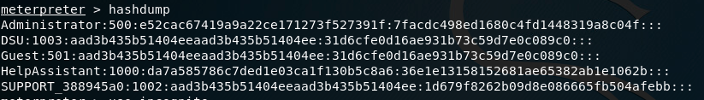
Pass the hash
Getting a hash when you can’t crack the password
No need for extra tools

Slide 9
Psexec w/ Pass the Hash
use exploit/windows/smb/psexec
All options normal
Until SMB Pass
Similar to running eternal blue psexec
Just set with the hash of the user

Slide 10
Meterpreter pivot
Built directly into meterpreter
Uses SMB Named pipes
Looks like normal traffic
Good for servers
Servers -> Internet = BAD
Servers -> Hosts -> Internet = GOOD

Slide 11
Moving Laterally on a Domain
Have a user account that is connected to a domain
Likely able to authenticate to similar types of computers
Check who the local computer has been talking to
ARP table, established/stale netstat connections
Tools
Powerview
Bloodhound

Slide 12
Socks proxy and proxy chains demo

